Slide 1

Python: Level 2
Session 1: Welcome (back).

Slide 2

About this Course
Who am I?
Who are you?
Course Aims

Slide 3
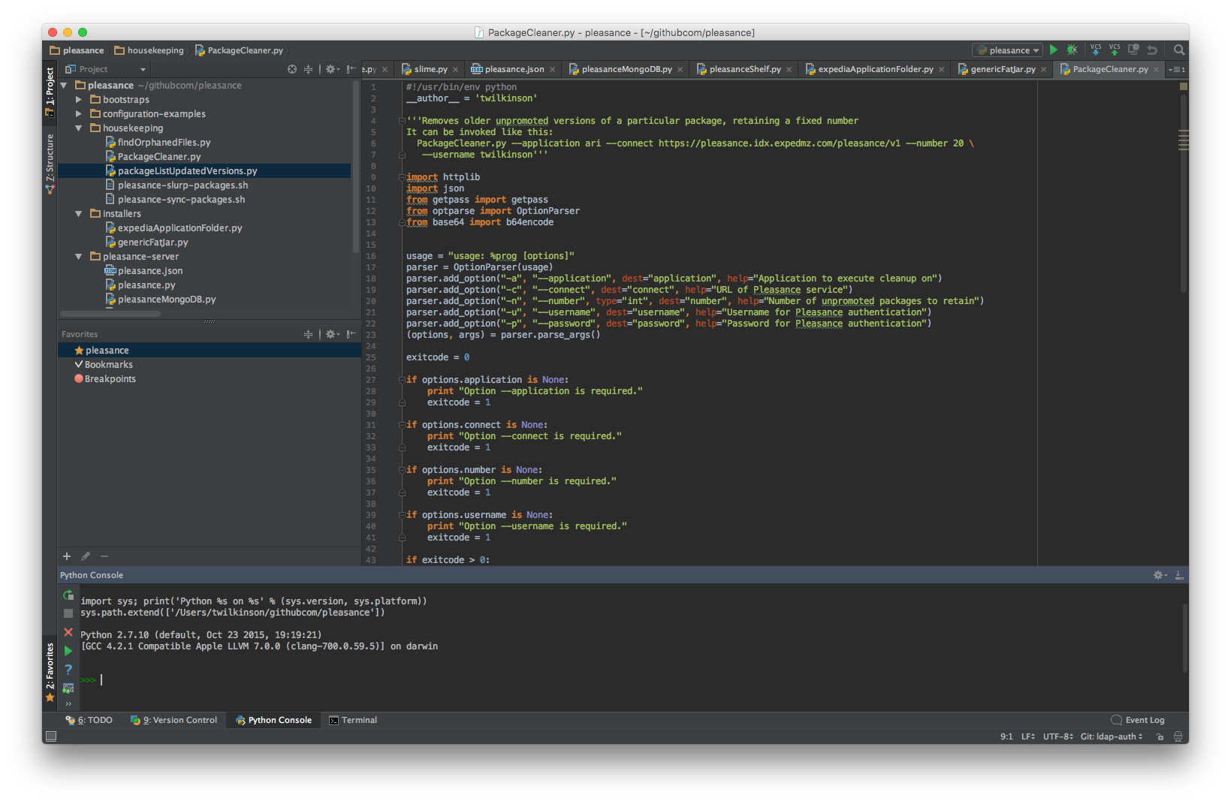
Recap: What do we need?
Python: version 2.7.x
A text editor:
Visual Studio Code
Sublime Text
PyCharm Community Edition
Anything with syntax highlighting for Python
Do not use:
Notepad
Notepad++

Slide 4
Recap: What went before
Take a look at http://go/5yvhzuq8
Download it and open it in your preferred editor
Let’s work through what it does.

Slide 5
Recap: What went before
Take a look at http://go/5yvhzuq8
Download it and load it into your preferred editor
Let’s work through what it does.
restaurants-lesson.1csv is at http://go/qzu9f-8p

Slide 6
What doesn’t it do?
What restrictions should be on the inputs?
Can you add a restriction to only allow the user to input numbers between 1 and 5 when searching on rating?

Slide 7
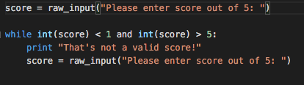
Did you come up with something like this?
Great! But there’s still a problem. What is it?

Slide 8
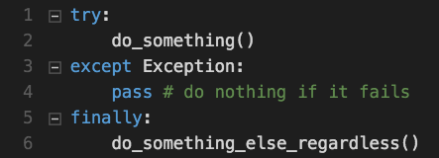
Let’s make an exception!
Try to do something
If that fails do something else (or don’t)
Finally, optionally, do something else
You can have multiple except blocks for different exceptions

Slide 9
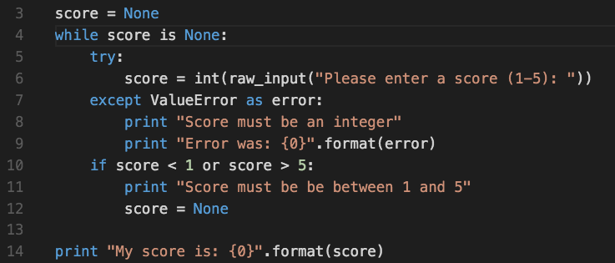
What does this do?

Slide 10
Exercise / Next week’s Class
Can you add input validation?
If I enter something that isn’t a number, print an error and ask again.
Next week: Building a library, no Dewey Decimal system required
Drop-in: Mondays, 11am in S32
Slack channel: #python-additional-eca1
Notes:
Extra credit: what happens if there’s no data file when we run our program? How can we change the code so that isn’t a problem?

